Slide 2
Golden Corral 2022
Department of Virginia 2022

Slide 3
We are dedicated to a single purpose: Empowering veterans to lead high quality lives with respect and dignity. We accomplish this by making sure veterans and their families can access the full range of benefits available to them; fighting for the interests of America’s injured heroes on Capital Hill; and educating the public about the great sacrifices and needs off veterans transitioning back to civilian life.
Department of Virginia 2022

Slide 4
Purpose
To prepare Chapters for upcoming Golden Corral fundraising season
Topics
Golden Corral (GC) & DAV Partnership
Department Coordinator Description and Responsibilities
Chapter Coordinator Description and Responsibilities
Golden Corral Stores and Supporting Chapters
Funds Distribution
New Rules for Funds Distribution
Income Use
New Memorandum of Understanding for 2023
Department of Virginia
Notes:
This presentation is meant to provide a preview of the upcoming GC season. No contact with GC for this upcoming campaign is established.
Many of the slides are from Sr. Vice Mitchell’s presentation from this fall.

Slide 5
Partnership
The idea of a Military Appreciation “Monday” program began when Mr. Hu Odom, Virginia Golden Corral Franchise owner, collaborated with a Past Department of Virginia Commander Charlie Craft to thank veterans and active duty military who served and continue to serve in our nations defense. Participation by other Golden Corrals throughout Virginia and in other states soon followed.
Mr. Hu Odom, originator of the Golden Corral Military Appreciation “Monday”, owns the BOTH, Inc. franchise in Virginia. Non-BOTH stores in Virginia are owned by other franchisees.
Golden Corral (GC) has provided more than 5.6 million free “Thank You” meals and helped raise ~$15 million dollars for DAV since the inception of the program in 2001.
Department of Virginia
Notes:
This is the History of the partnership.
Our goal is get GC started much sooner. Last year, we were not informed until October and then we “all” jumped in feet first at the last minute.
This year, you have time to start preparing your membership for the campaign and we can emphasize the GC as a priority.

Slide 6
Partnership
The DAV fundraising activity will take place from several days to several weeks leading up to Veterans Day.
Military Appreciation Night will be held Monday November 14th.
Please ensure you have members working on Veterans Day to ensure that folks know the meal is not until Monday.
Department of Virginia

Slide 7
Partnership
The Golden Corral Fundraiser is a Department fundraising activity!
Golden Corral Corporate prefers to interface with the Department of Virginia
Once underway, the individual stores coordinate with the Chapter focal point(s)
Participating chapters receive the majority share of funds raised from this event, which enhances the level of assistance that can be provided to veterans and their families in each chapters community.
Department of Virginia
Notes:
This program started in Virginia. Bob Bent from Ch. 48 told me about the history of the program during fall conference 2021.
It started here and became a national program, we all must put our best efforts in making it a success and re-building it to prior covid levels.

Slide 8
Department Coordinator
Department Senior Vice Commander
Responsible for Golden Corral fundraising event in Virginia
Primary contact person for ALL issues
Develops fundraising guidance and conducts Department training
Mediates disagreements between chapters and coordinates issues between Chapters and GC Managers
Approves distribution of funds from chapter participants
Department of Virginia
Notes:
Per our Department By-laws, the Dept. Sr. Vice is the GC Coordiantor.
Department of Virginia DAV Constitution and Bylaws, Article II, Section Sec 2-2, Para 2

Slide 9
Chapter Coordinator
Designated by the Chapter Commander
Prepares Memorandum of Agreement between DAV Chapter and Golden Corral Store.
Provides fundraising training and guidance to all DAV and Auxiliary volunteers
Prepares and maintains a volunteer schedule
Informs all volunteers of changes to procedures
Monitors (spot checks) shifts at the stores to ensure compliance
Ensures all funds collected are accounted for nightly by the Manager on duty and verified
As necessary, interacts with the Department Coordinator
Completes and submits the chapters Memorandum of Agreement, After Action Report and Complete Shift Sign-in sheets to the Department.
Department of Virginia

Slide 10
Funds Distribution-Both Inc.
Single Chapter
Shift Sign-in sheets MUST be sent to the Department Coordinator upon conclusion of the event
BOTH Inc. will provide a spreadsheet of deposits to the Department Coordinator that reflects the total funds collected
BOTH Inc. will send a check for 83% of the proceeds to the Chapters
The remaining 17% of the gross donations will be sent to the Department of Virginia
Department of Virginia
Notes:
Be sure to put the correct mailing address on your officer election reports and the correct one is provided to GC if the check is being mailed. We had a difficult time with this the past few months.

Slide 11
Funds Distribution-Both Inc.
Two or More Chapters
Shift Sign-in sheets MUST be sent to the Department Coordinator upon conclusion of the event
The GC Corporate Office will send a check for 17% of the gross donations to the Department of Virginia
The Department Coordinator will verify the Sign-in sheets and authorize distribution of the remaining 83% of gross donated funds to the Chapters, based on the MOA between the sharing Chapters
BOTH Inc. will send checks to the Chapters, as directed by the Department Coordinator
Department of Virginia

Slide 12
New Funds Distribution for Independent Franchise
To accommodate a new procedure for Independent Franchise’s, due to previous noncompliance by some chapters and for clarity, each GC Independent Franchise will send all proceeds to the Department of Virginia rather than to the chapters.
The Department GC Coordinator will be responsible to ensure the Independent Franchise sends the full amount of the proceeds to the Department. Once the Department GC Coordinator receives acceptable required paperwork from the chapter, he/she will notify the department to release funds to the chapter.
Upon notification by the Department GC Coordinator the department will issue a department check for (83%) of the proceeds to the chapter. Required paperwork include: Memorandum of Understanding, sign-in sheets and the After-Action Report.
If two or more chapters are assigned to a store, each chapter must send in their own sign-in sheets and their own after action report.
Department of Virginia
Notes:
Purpose is to ensure that all monies received from Golden Corral are accurately reported on the AFR. In the past, some chapters have not submitted paperwork and because they’re below the $25k threshold, an AFR was not completed.

Slide 13
Income Use
Other Fundraising Activities:
Income from approved Department or Chapter fundraising activities shall be used to support programs and activities sponsored by DAV, its subordinate units or other entities, as long as such programs and activities provide a direct and substantial benefit to disabled veterans, their dependents and survivors
All net income raised from fundraising projects shall be required to be devoted, within a reasonable time, to the cause or program for which it was intended.
Department of Virginia
Notes:
FMN: NEC Reg 5., OfA 1
OfA 2:Article 15, Sec 15.3 par 10

Slide 14
Memorandum of Understanding
We will no longer require a manager’s signature.
Meet with the GC Manager/GM to discuss the start date, shifts and any other pertinent details for the upcoming season
Complete a MOU. The MOU is a written understanding provided to GC as a means of what the store can expect for support from the chapter
If two or more Chapters are sharing a GC location, all coordinators need to review the MOU with their Chapter CEC. Then sign for the MOU
Once the MOU is signed, any changes must be agreed upon by all parties. Changes cannot be made at the last minute without both parties agreeing to the change
Email the Department Coordinator the MOU
Provide a copy of the MOU to the GC Manager/GM
Department of Virginia
Notes:
Couple of points.
When a MOU is agreed upon, get signatures from all parties. Other chapters sharing the store.
It is important that the MOU is reviewed by your CEC prior to signing. Once the MOU is signed by all parties, it should not be changed.
Get your paperwork in on time. The Sr. Vice should not have to track down your representative to ask about documentation, at any point.

Slide 15
Memorandum of Understanding
DAV Chapter 102, Golden Corral Fundraising Campaign
Memorandum of Understanding
This Memorandum of Understanding (MOU) is created between Chapter 102 and Golden Corral Store #777 on 26 August 2022.
The members of Chapter 102, agree to work with the manager of Golden Corral Store #777 during the Department fundraising campaign to assist DAV.
We will have members available in the store to answer questions and promote DAV activity starting Friday, 11 October 2021 through Thursday, 11 November 2022, during the following times:
Monday thru Friday, 11:00 a.m. to 8:00 p.m. (three shifts), and Saturday and Sunday from 8:00 a.m. to 8:00 p.m. (four 3-hour shifts). On Monday, 11 November, every member available from the Chapter will be present from 9:00 a.m. to 9 p.m. to support Golden Corral Military Appreciation Night.
In the event no chapter member(s) are present to man the DAV table, please contact the following individuals in-turn:
Primary­ Alternate - Name and phone number
Alternate - Name and phone number
Tertiary - Name and phone number
Signed by:
Manager Golden Corral
Chapter Coordinator
Department of Virginia
Notes:
This is an example of a MOU, due to GC Dept. Coordinator prior to starting campaign.

Slide 16
Helpful Tools
Example of a “cheat sheet” used at the table to assist volunteers in answering, what is DAV and what does DAV do to help veterans:
Info for Golden Corral for Chapter 3
Chapter 3 provides an Honor Guard team, free of charge, to every deceased veteran in SW Virginia at burial/cemetery. We provide a rifle team, a bugler, and when active duty is not available, the flag folding and presenting to next of kin. We number 80 to 100 funerals a year with an all volunteer team that are all disabled veterans.
We provide on average $1,000 to $1,500 in emergency relief to veterans in SW Virginia in crisis every month. This includes rent for eviction notices, utility cut-off notices and groceries and gas.
We provide free VA disability claim assistance and processing with trained Chapter Service Officers.
We fund VA charities such as aquatic therapy at the Salem VAMC for veterans, to include a van for veteran transportation used by the VA for veteran medical appointments.
We open our doors to support other Veteran Service Organizations for meetings at our property on a monthly basis.
We provide a place for veterans to socialize and interact at our property with food service on site. (2381 Roanoke Blvd Salem, VA 24153 across and down the road from the Salem VAMC).
We provide homeless veterans clothing and furniture, free of charge ,when starting over in their new home. We assist with housing, in conjunction with, the Social Worker at the Salem VAMC. We assist Veterans in finding employment in our local community with our DAV State Employment Committee.
Department of Virginia
Notes:
Cheat Sheet example from Ch. 3

Slide 17
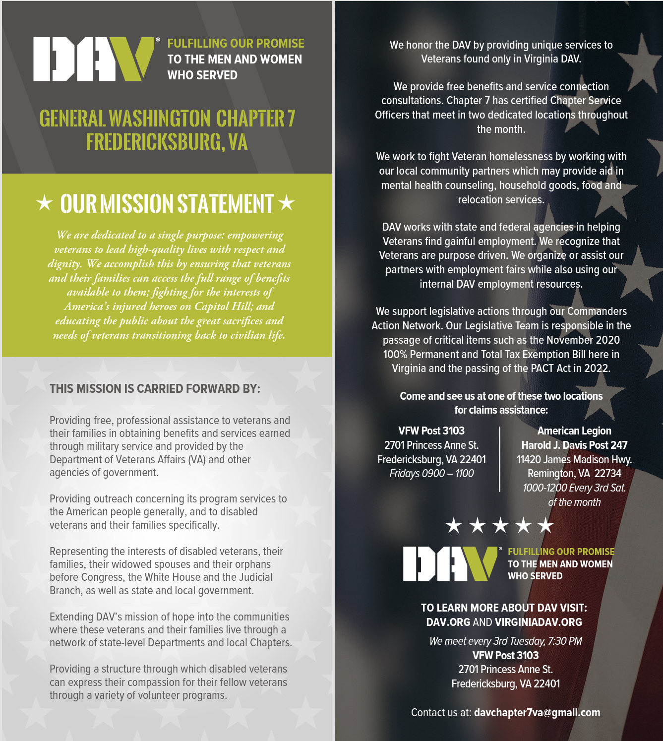
Helpful Tools
Department of Virginia
Notes:
Rack card. Like a pamphlet made by national but featuring your chapter. Thank you to Auxiliary Unit 50 for the great idea.
Contact Ch.50 to speak with Auxiliary member that can assist with order.

Slide 18
All Things Considered
Times are tough, this is not new but…
Inflation
School is in session, meaning expenses for after-school activities
Price of petroleum
Closing of stores from COVID, limiting partnerships
Some volunteers are not comfortable with “sales”
Do the best you can
Department of Virginia

Slide 19
References
Please refer to the following for further guidance
National Constitution and Bylaws, Article 15, Section 15 (all) but specific: Sec 15.3 Para. 10, NEC Regulation 5
Department of Virginia DAV Constitution and Bylaws, Article II, Section Sec 2-2, Para 2
Article VII
Chapter C&B
Department of Virginia

Slide 20
Questions
Department of Virginia

Slide 21
Department of Virginia Disabled American Veterans P.O. Box 7176 Roanoke, VA 24019-0147 540-206-2575 toll free: 866-706-5889 www.VirginiaDAV.org @DAVVirginia
© 2022 DAV-Department of Virginia. ALL RIGHTS RESERVED
No part of this work covered by the copyright herein may be reproduced or used in any form or by any means without permission from DAV-Department of Virginia

