Slide 2
ANNUAL FINANCIAL REPORT (AFR)

Slide 3
Instructor
Rita Aberegg, PDC
Chair, Department Audit Committee

Slide 4
DAV Mission Statement
We are dedicated to a single purpose:
Empowering veterans to lead high quality lives with respect and dignity. We accomplish this by making sure veterans and their families can access the full range of benefits available to them; fighting for the interests of America’s injured heroes on Capitol Hill; and educating the public about the great sacrifices and needs of veterans transitioning back to civilian life.

Slide 5
What Am I To Do with the AFR ?
We had money left over from last year
We received money this year
We spent money
We now have money left over
Begin with the previous year’s AFR Ending Balance
as your Beginning Balance for the current year
REMINDER: DAV’s Fiscal Year (FY) is 01 July through 30 June

Slide 6
Income: Lines 1 through 6
Line 1: National disbursements (Membership Dues)
Line 2: Funds generated from Forget Me Not Drives
Line 3: Bingo proceeds (if not at VAMC or nursing facility)
Line 4: Thrift Stores funds received
Line 5: Bar or Lounge GROSS receipts including pull tabs and video machines
Line 6: All interest & dividends from checking & savings accounts

Slide 7
Income Lines 8 through 10
Line 8: Investments
In many cases, this figure is an adjustment figure because you knew the value at the beginning of the Fiscal Year.
You know the value of the investments at the end of the Fiscal Year.
If the difference is Positive, it belongs on Line 8
Line 9: Any other income not accounted for on lines 1-8
(i.e. donations, bingo at VAMC, etc)
Line 10: Add lines 1 through 9

Slide 8
Expenses: Line 11 and 12
Line 11: Salaries of paid employees (except those listed below)
CSO/DSO and HSC’s - line 14
Bingo employees - line 16
Bar/Lounge employees - line 18
Line 12: Conference & Convention expenses
Rooms
Travel (mileage/air/rail)
Hospitality Rooms
List individuals separately for each meeting and expense

Slide 9
Expenses: Line 13 and 14
Line 13: Postage and Office Supplies
NOTE: if these expenses are Service Related; DSO/CSO - Line 14
Line 14: Service and Charitable Expenses
These expenses are for service programs and activities that provide DIRECT and SUBSTANTIAL benefit to disabled veterans and their families (Emergency Relief, Dept. Committees, NSF, NDVWSC, etc.)
This category is one of the hardest to justify
Food for Chapter Meetings is Line 21
Some Fund Raising is Line 21
Must substantiate with receipts or other supporting documentation

Slide 10
Expenses: Line 15 through17
Line 15: Forget Me Not Drive Expenses
Flowers
Cans
Materials from DAV National Headquarters
NOTE: Meals for Volunteers go on Line 21
Line 16: Expenses for Bingo outside a VAMC
NOTE: Bingo within VAMC’s and Nursing Homes is Line 14
Do You Currently Operate a Thrift Store?
Contact Department Adjutant Lisa Gregory ASAP for guidance

Slide 11
Expenses: Line 18 and 19
Line 18: Bar & Lounge expenses
Line 19: Chapter Home Expenses
Rent
Mortgage
Utilities
Repairs and Maintenance
Office Furniture
Meeting Supplies
Expenses directly related to monthly membership meetings

Slide 12
Expenses: Line 20 and 21
Line 20: Decrease in Market Value of Investments from Line 26
This figure is calculated from what the investments were worth at
the beginning of the Fiscal Year and what they are worth at the end of
the fiscal year
If the investment has decreased in value, the difference goes here
Line 21: Other Expenses
Awards
Gifts
Pins
Any expense not listed on lines 11 through 20

Slide 13
Expenses: Line 22 and Ending Balance
Line 22: The total expenses of lines 11 through 21
Ending Balance: This is the Beginning Balance, plus
Line 10 Total Income, minus Line 22 Total Expenses
This figure must agree with the Total Liquid Assets on Line 27 of this report

Slide 14
Liquid Assets: Lines 23 through 27
As of 30 June each year, the following amounts must be listed
Line 23: Amount of money in checking accounts and cash on hand
Line 24: Amount of Money in Savings Accounts
Line 25: Certificates of Deposit
Line 26: The total Market Value of Investments
Line 27: Add Lines 23 - 26 to get the Total Liquid Assets
This figure must equal the amount on Ending Balance.
If they don’t, you can’t submit your report; you have an error.

Slide 15
AFR Assistance Contact
Rita Aberegg, PDC
Chair, Department Audit Committee
E-mail: ms_DAV@cox.net
540-538-9956

Slide 16
Questions

Slide 17
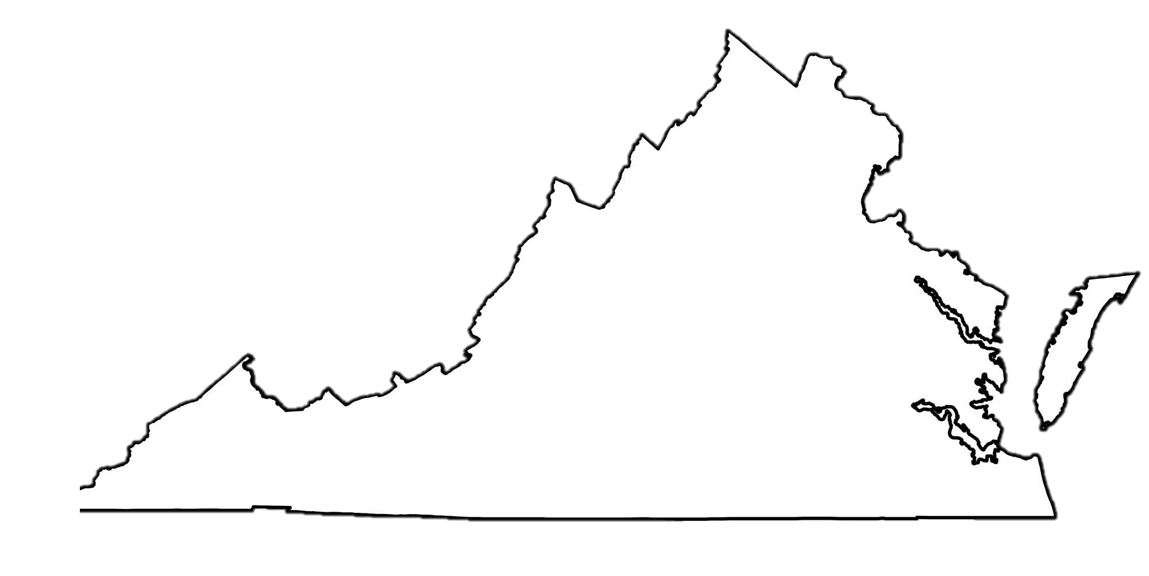
Department of Virginia Disabled American Veterans P.O. Box 7176 Roanoke, VA 24019-0147 540-206-2575 toll free: 866-706-5889 www.VirginiaDAV.org @DAVVirginia
© 2024 DAV-Department of Virginia. ALL RIGHTS RESERVED
No part of this work covered by the copyright herein may be reproduced or used in any form or by any means without permission from DAV-Department of Virginia

