Slide 2
Chapter Commander Reports
Department of Virginia 2022

Slide 3
Department Website Overview . Department Administrative Information Section
Department of Virginia 2022

Slide 4
Instructor
Jim Procunier, PDC
Webmaster

Slide 5
Background
www.VirginiaDAV.org
The current website was developed in the fall of 2016
As of 2-23-22: 48,847 visits to the website
over 8,800 visits per year !
VirginiaDAVinfo@gmail.com was established to
allow veterans to contact us with questions,
not for submission of reports or documents
to headquarters
In-person Chat feature established in 2020 to allow veterans and the public to get quick answers

Slide 6
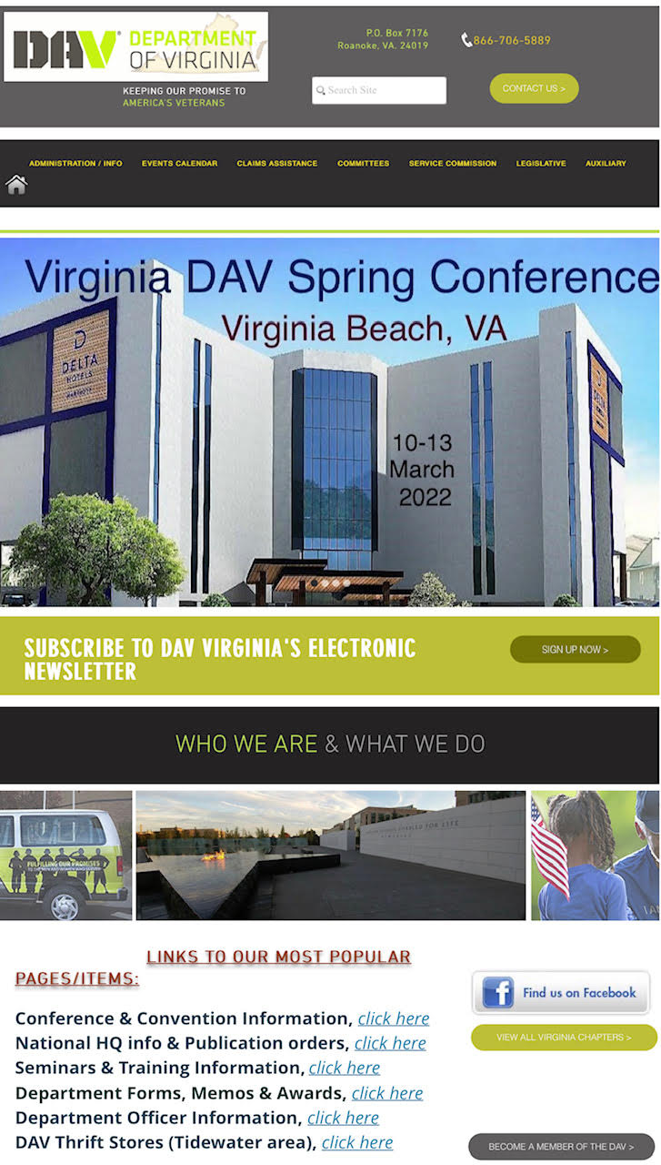
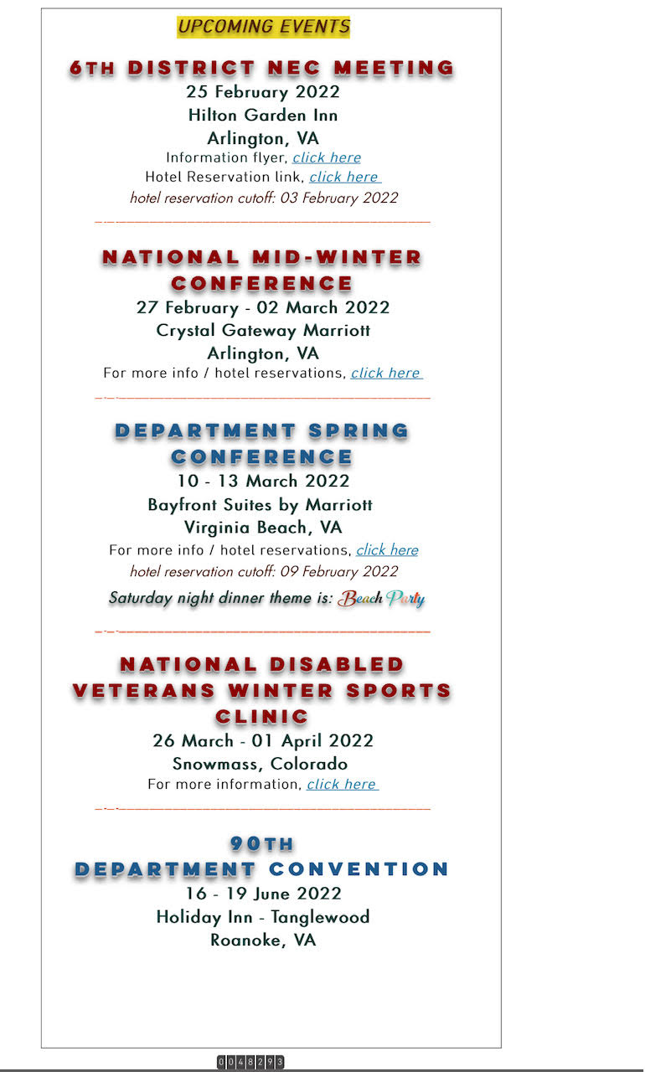
Landing Page
Top part of page
Mid part of page
Search feature
Menu Bar with dropdowns
Events/Info scroll
Upcoming events
Popular page links

Slide 7
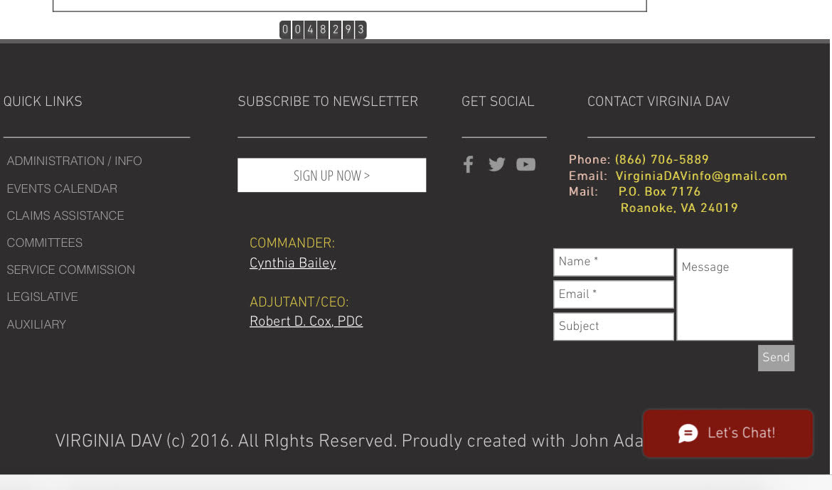
Landing Page
Bottom part of page
Contact Info & email block
Quick Links
Chat Feature

Slide 8
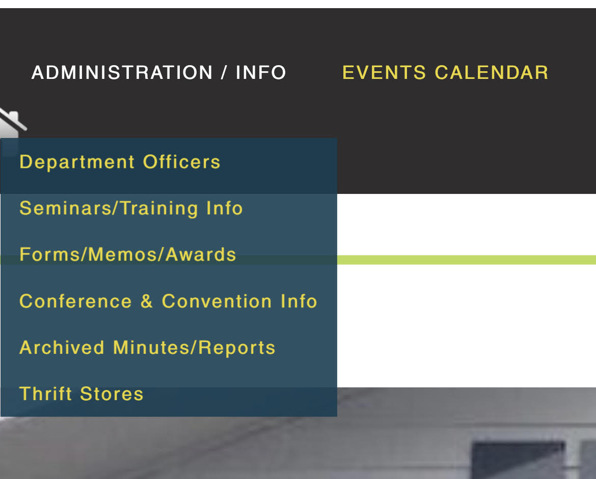
Drop Down Menus
Each item at the top of the page has a drop-down menu with more pages.

Slide 9
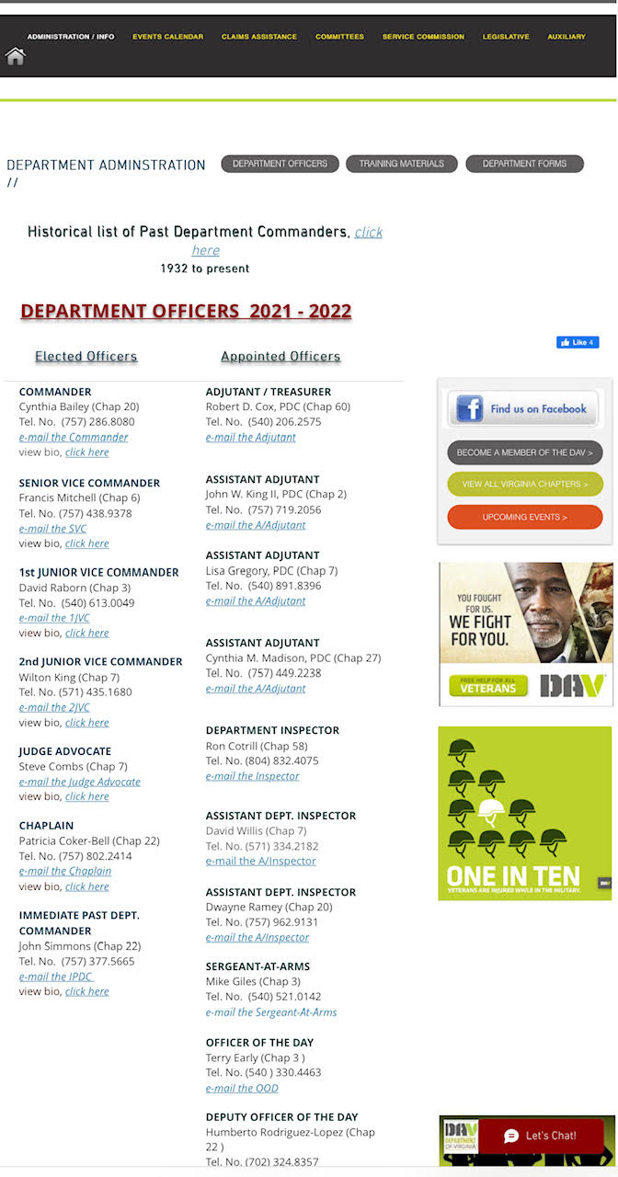
Department Officers
Additionally, a historical list of past Department Commanders is
located here.
Names, bios and contact information for elected and appointed Department Officers are found here.
To email anyone, click on the e-mail link.

Slide 10
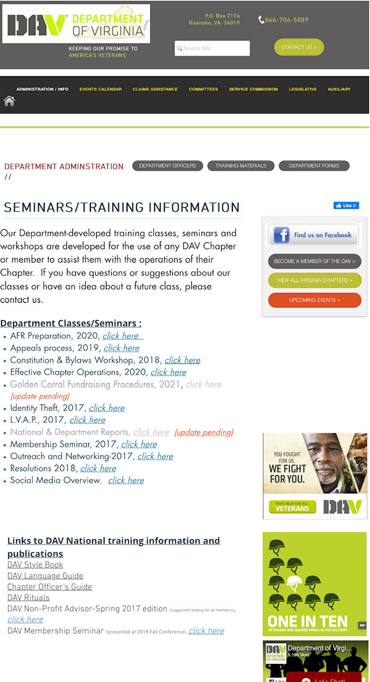
Seminars / Training Information
Seminars and classes presented at Department Conferences are posted here and may be utilized by our Chapters.
Other Departments as well as Chapters from other states have used our materials....Virginia leads the way in training !

Slide 11
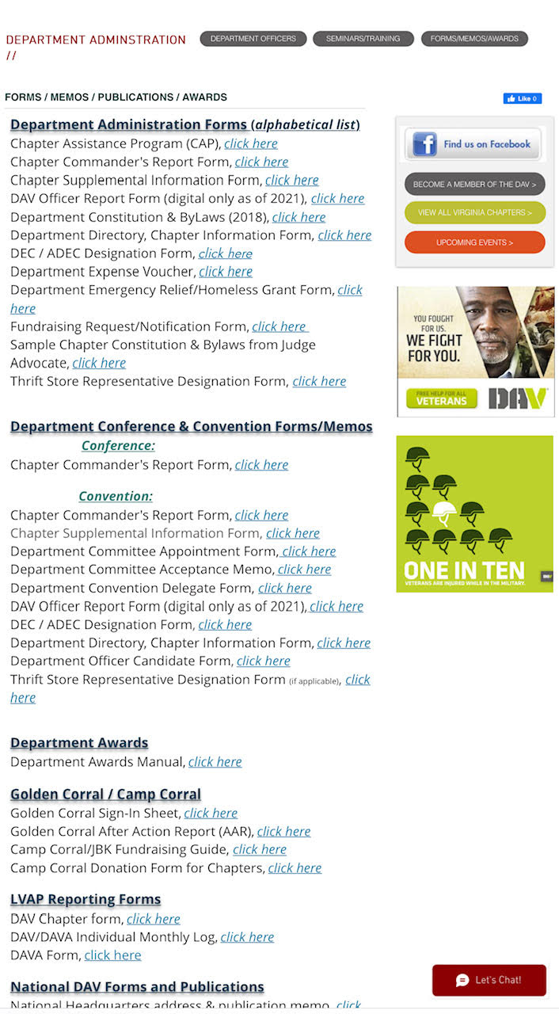
Department Forms
For Department forms, there is an alphabetical list, a section that separates the forms into Conference and Convention forms, Department awards, Golden Corral /Camp Corral, and LVAP.
The bottom half of the page has various National DAV forms and publications.

Slide 12
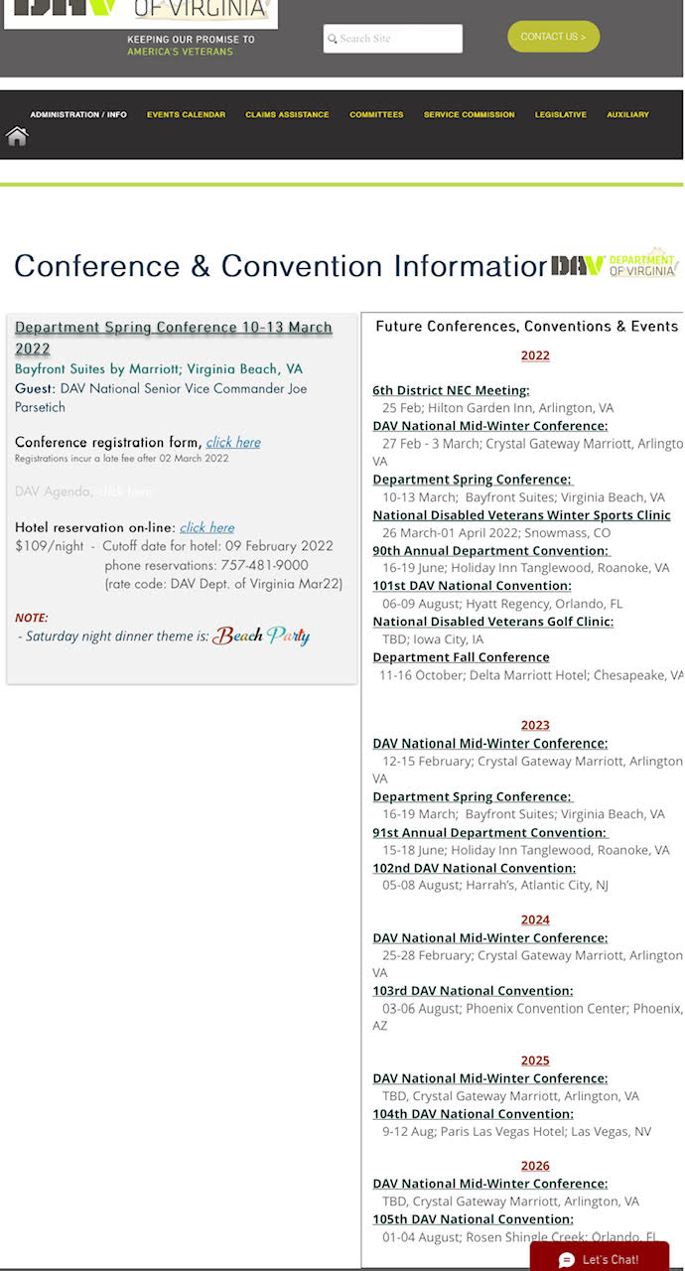
Conference & Convention Information
The next department event is on the left side of the form, with links to the hotel, conference registration, the Agenda, etc.
Future Department and National events out 4 years are on the right side.

Slide 13
Other Menu Options
Other drop-down menus at the top of the page link to:
Events Calendar
Claims Assistance
Department Committees
Service Commission
Legislative
Auxiliary

Slide 14
Summary
Look under the Administration/Info tab for Department Officers, Forms, Classes, Conference and Convention information, and archived reports.
Do not send any reports or documents for the Department office or Adjutant via the VirginiaDAVinfo@gmail.com email account. They will not be forwarded for you.
Adjutant’s email: DAVadjutantVA@cox.net
Office email: VirginiaDAVhq@cox.net
Any questions about the website or contents contact the
Social Media Committee: SMC.VirginiaDAV@gmail.com
All emails and phone numbers for Department Officers and Committees are on the website.

Slide 15
Questions

Slide 16
Chapter Commander Reports
Department of Virginia 2022

Slide 17
Department of Virginia Disabled American Veterans P.O. Box 7176 Roanoke, VA 24019-0147 540-206-2575 toll free: 866-706-5889 www.VirginiaDAV.org @DAVVirginia
© 2022 DAV-Department of Virginia. ALL RIGHTS RESERVED
No part of this work covered by the copyright herein may be reproduced or used in any form or by any means without permission from DAV-Department of Virginia

Slide 18
18

